Slide 1




Multi-loss Function to Improve the Text Detection and Segmentation
Problem Statement –
"Slidin' videos": Slide Transition Detection and Title Extraction in Lecture Videos
ITU AI/ML in 5G Challenge 2022
Team: AA_Vision
Dr. Anuj Abraham
Senior Researcher
TII, UAE.
Dr. Shitala Prasad
Scientist II
A*STAR, Singapore.

Slide 2
Outline
Introduction 3
Problem Definition
Motivation
Proposed Solution 7
Key contribution
Results 9
Comparison
Ablation study
Conclusion 13
2

Slide 3
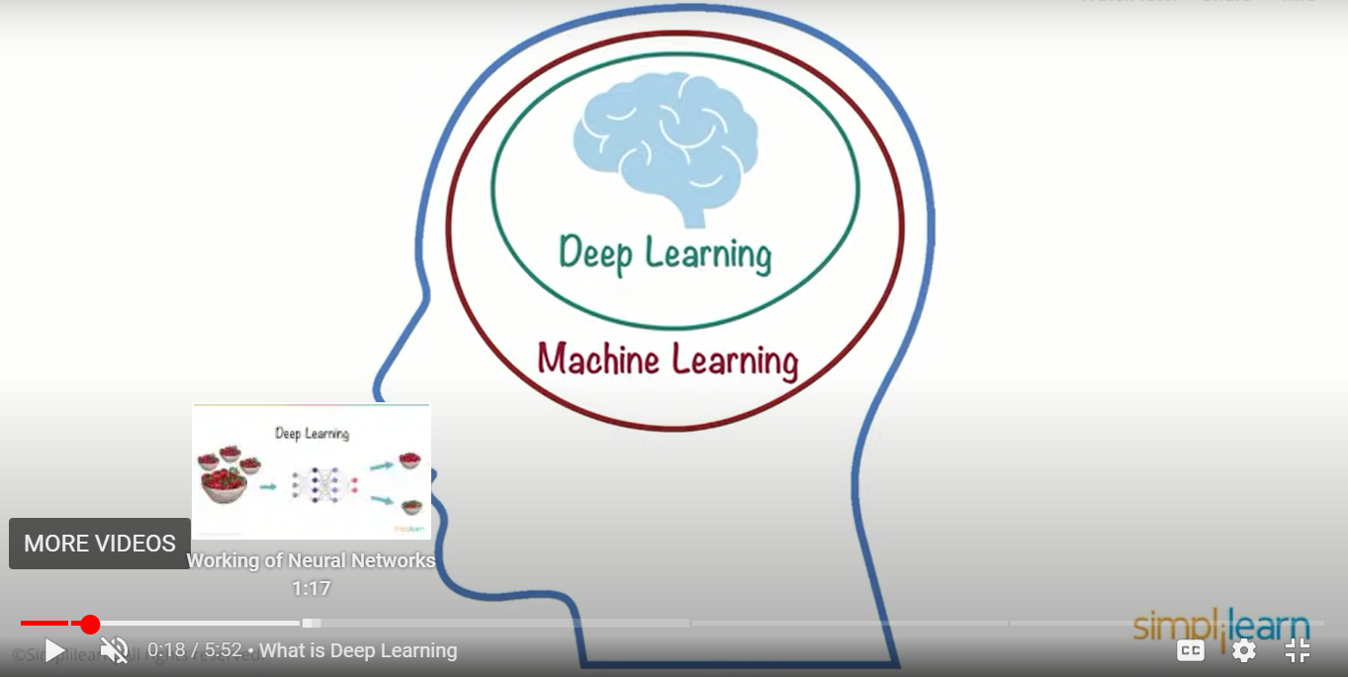
Introduction
YouTube’s “Video Chapter” feature segments a video into sections marked by timestamps so that the user can easily navigate to the part of the video which is of most interest. This can be done by clicking or pressing the chapter marker, or by selecting the timestamp in the video description – (AI-5G Challenge)
3

Slide 4
Introduction: Problem Definition
AI model which annotates slide transitions by:
Identifying starting and ending frames of each slide shown in the video
Extracting (apparent) titles of each slide
All videos were recorded at 25FPS
Dataset:
Video files covering the presentation from when speaker started screen share right to the moment when it was turned off. Video files vary in duration (from several minutes to several hours) and resolution (from 1600 x 1200 to 3840 x 2160).
A ground truth data set with 2500+ slide transitions showing the starting and ending frame of each slide including (apparent) titles.
4

Slide 5
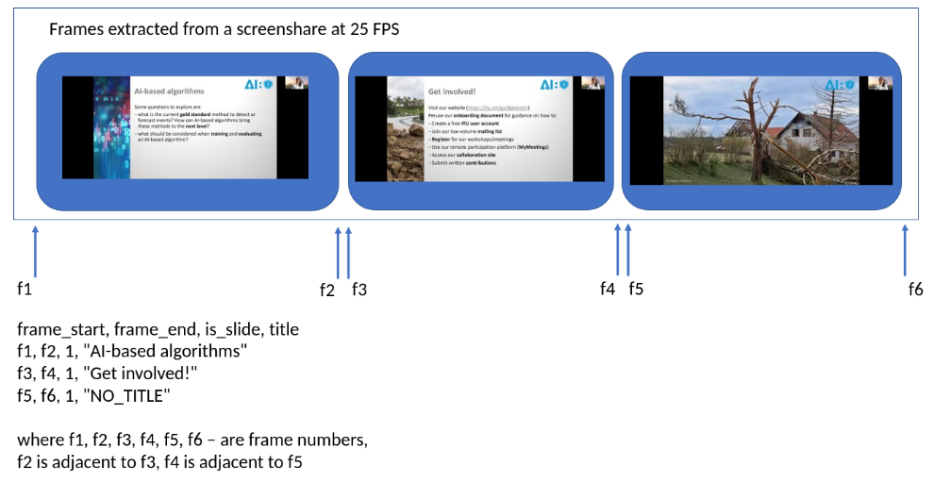
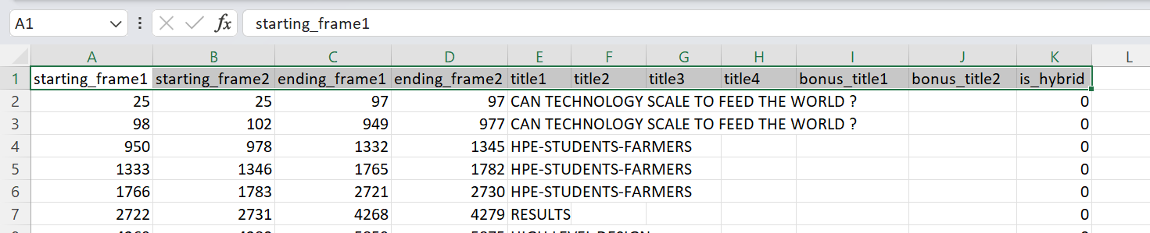
Introduction: Problem Detail
“groundtruth.csv”
5

Slide 6
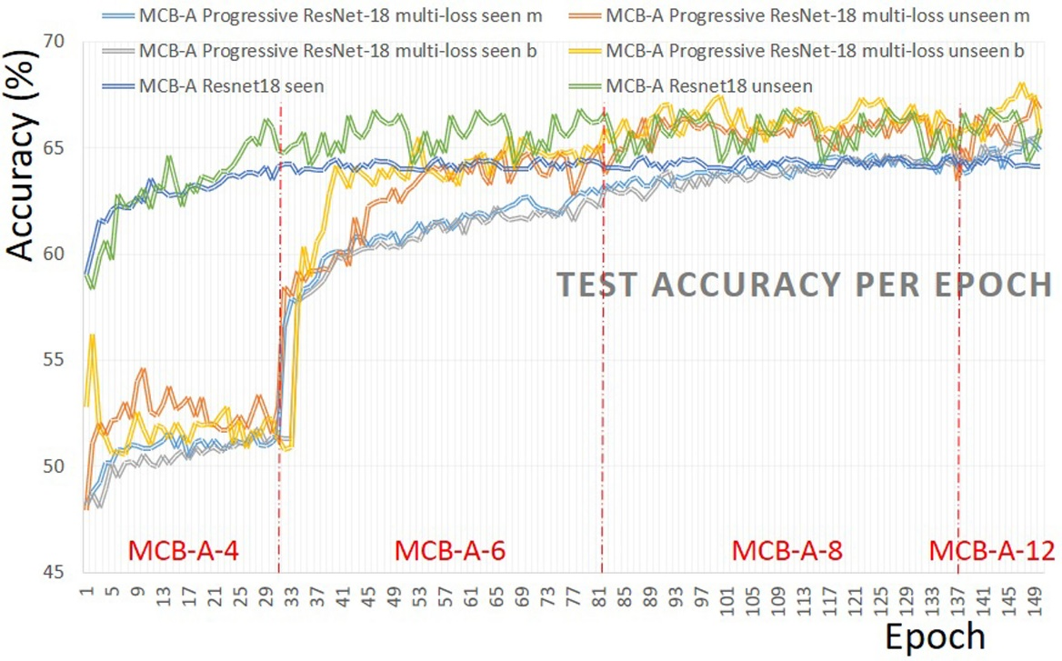
Introduction: Motivation
YouTube introduced a multi-loss view invariant stochastic prototype embedding to minimize and improve the recognition accuracy of novel objects at different viewpoints by using a progressive multi-view learning approach.
Prasad, S., Li, Y., Lin, D., Dong, S. and Nwe, M.T.L., 2021. A Progressive Multi-View Learning Approach for Multi-Loss Optimization in 3D Object Recognition. IEEE Signal Processing Letters, 29, pp.707-711.
Multi-loss in Detection and Segmentation
6

Slide 7
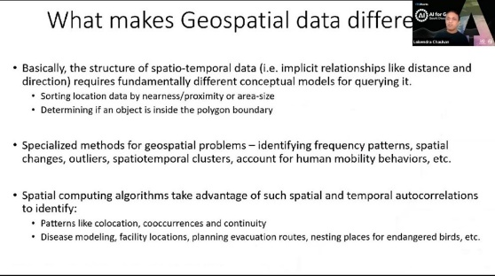
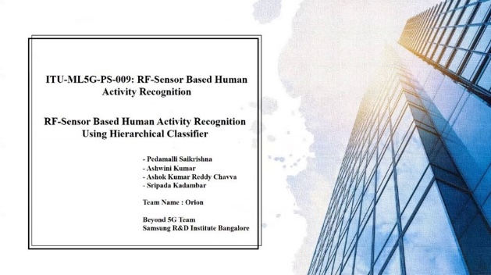
Traditional
Proposed Solution
Single loss
Multi-loss
Deep Feature Extractor
Predi-ction
Dataset
Methodology: Multi-loss Function to Improve the Text Detection and Segmentation
Proposed

Slide 8
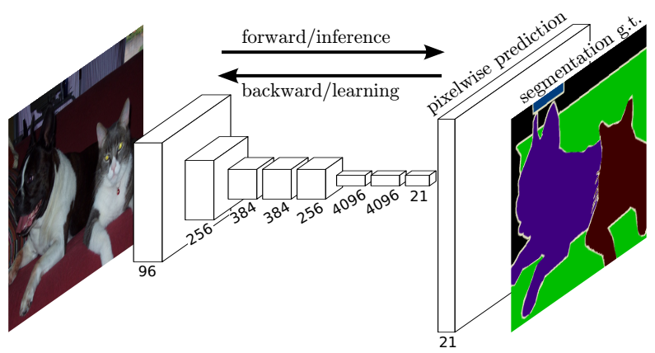
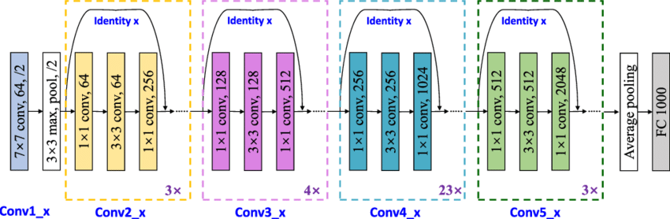
Proposed Solution
Advantages :
Model used ResNet101 (createDeepLabv3)
No architectural changes
Negligible model computation cost (equivalent to the original)
Multi-loss training strategy converges the network much faster
Gives a significant boost in the performance by ~5%
ResNet convolutional layers
VGG convolutional layers
https://github.com/msminhas93/DeepLabv3FineTuning/blob/bcdc3dfc79a5b75bc30c52b32315661c0a4da17e/model.py#L6

Slide 9
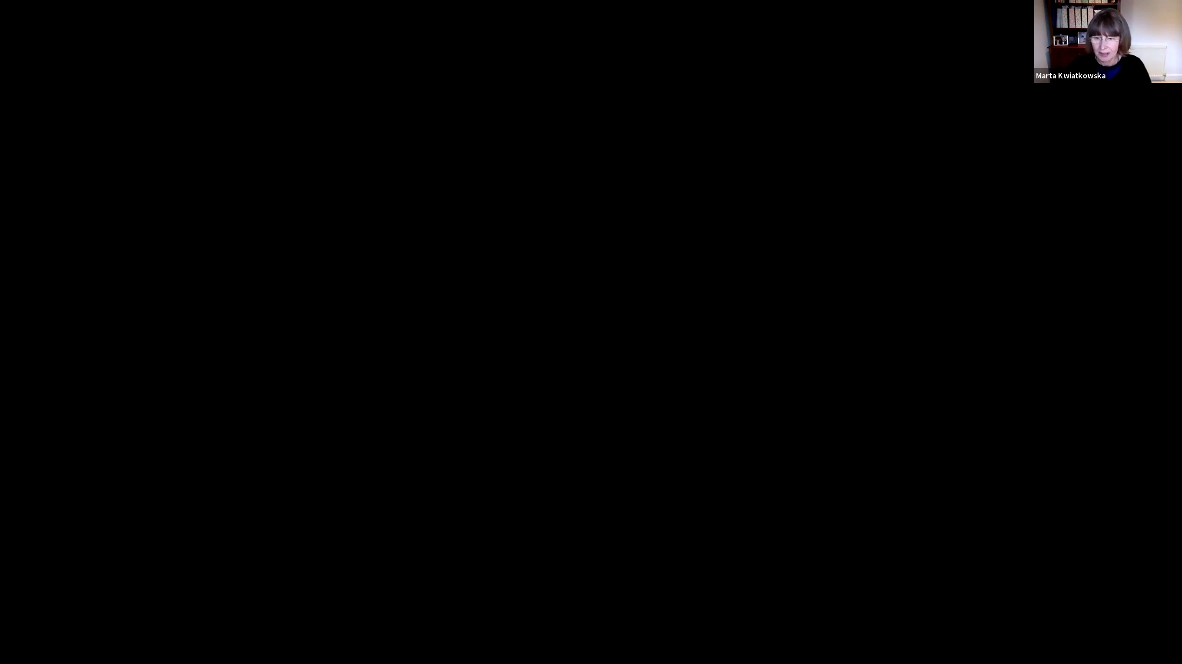
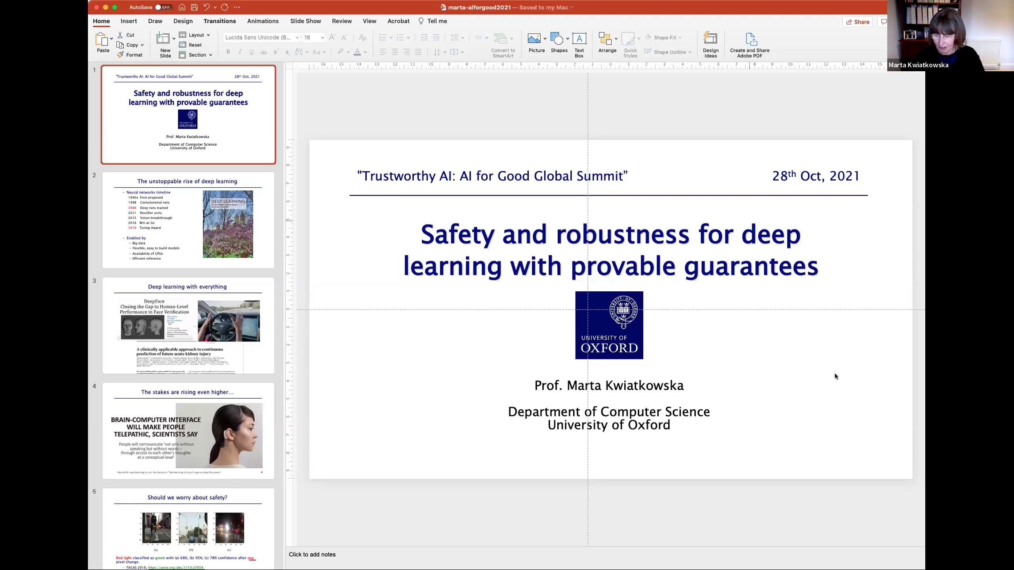
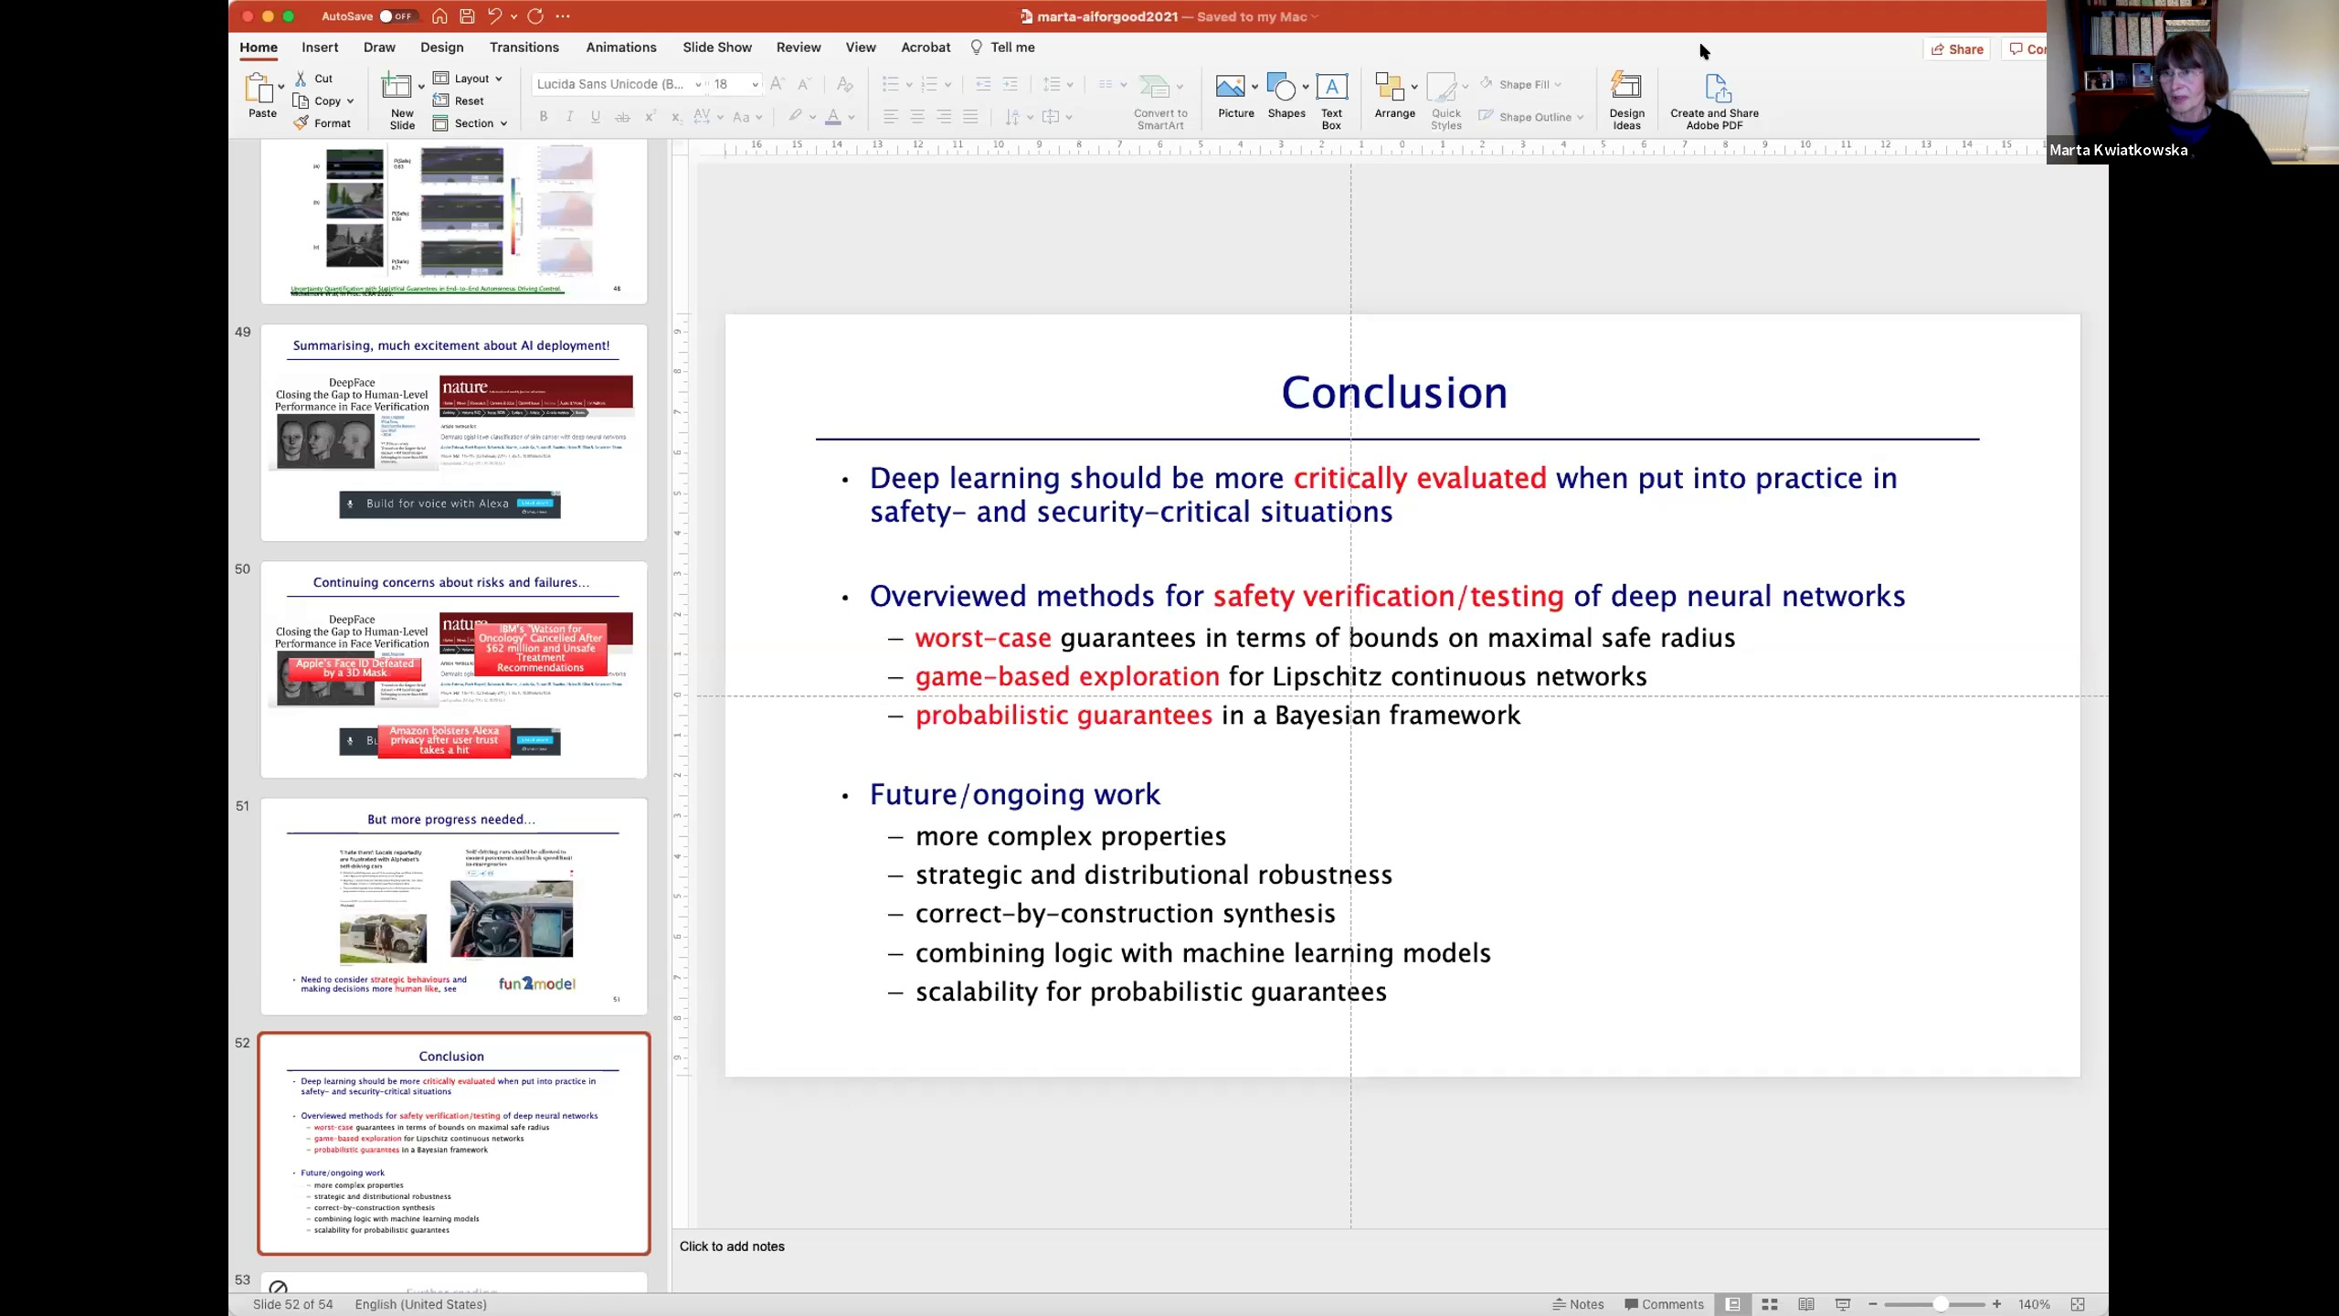
Proposed Solution: Dataset Preparation
Since this challenge has video as the input source, we needed to extract frames from these video files for feeding deep model. Therefore, for dataset preparation we used following steps:
The videos frames per second (fps) is 25
Use video files to extract images, 25 frames per second video
That is, if the video is of X length, the total number of frames will be X(minute)*60(second)*25(fps)
Once the images are extracted, they are categorized into training and validation sets
There are three types of images: no title, same title and new title slides
No Title Slide
Title Slide
Title Slide

Slide 10
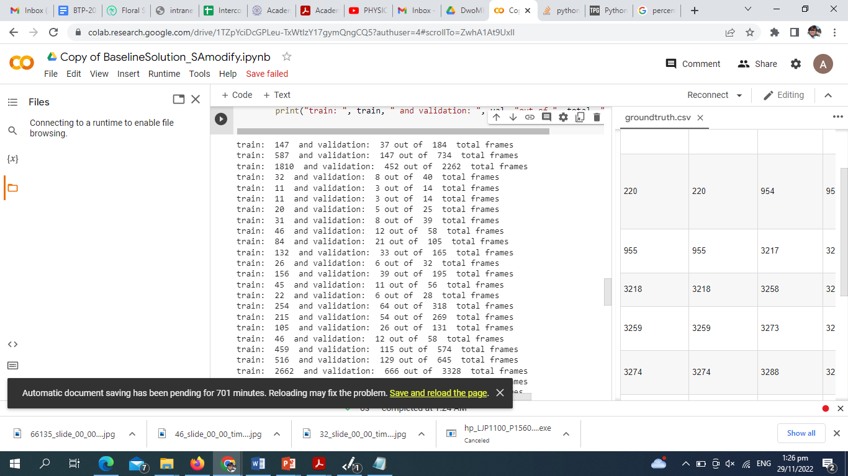
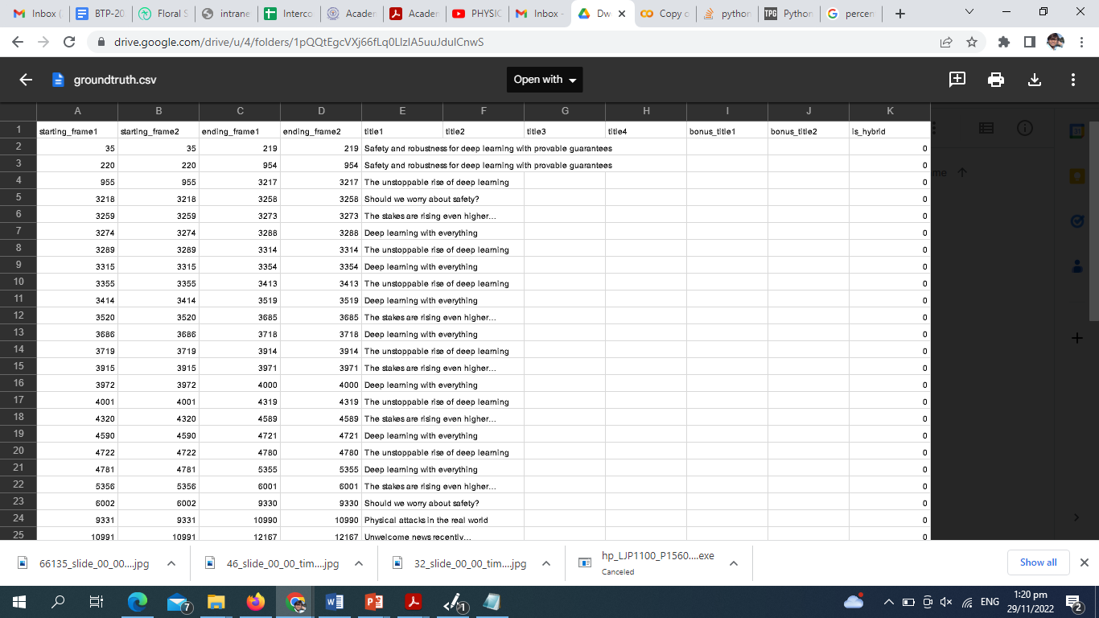
Proposed Solution: Dataset Preparation
Creating training and validation sets
From the ground truth CSV file, we extracted the number of frames with the same titles by using starting and ending frame numbers
Split the computed frame number by 80%-20%
Using the frame number, split the dataset
No Title Slide
Title Slide
Title Slide

Slide 11
Proposed Solution: Dataset Preparation
Creating training and validation sets
From the ground truth CSV file, we extracted the number of frames with the same titles by using starting and ending frame numbers
Split the computed frame number by 80%-20%
Using the frame number, split the dataset
Threshold for title search

Slide 12
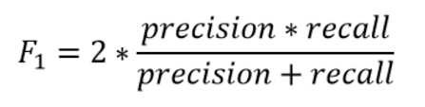
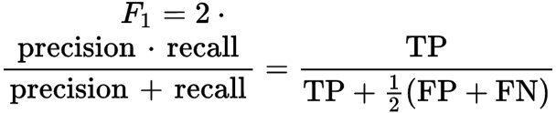
Results: Comparison
Metrics | Baseline | Proposed Multi-loss (4)
Epochs | 10 | 10
Train Loss | 0.00279 | 0.00192
Train F1 | 0.853 | 0.911
Train AUROC | 0.993 | 0.990
Test Loss | 0.0241 | 0.0200
Test F1 | 0.764 | 0.812
Test AUROC | 0.925 | 0.949
Average of three runs
We used MAE, MSE, MSLE and variations of Huber loss functions for our experiments
Evaluations:
https://www.analyticsvidhya.com/blog/2020/06/auc-roc-curve-machine-learning/

Slide 13
Results: Ablations Study
13

Slide 14
Results: Ablations Study
14
Notes:
F1= (0.812-0.76)*100=5.2%
AuROC is the cost difference of accuracy between the ROC curve for the baseline and proposed: Basically, area under the curve.
AUROC=(0.949-0.925)*100=1.9%

Slide 15
Results: Ablations Study (Computations))
15
Notes:
Not all loss suitable for this task. We had tried for 5-6-7 loss, not much improvement.
Also. There is no point in simply using all loss function without knowing their purposes.
Proposed 4-loss uses computation cost of 86/137*100=62.8%,
Saving 37.2% of computation cost from the baseline

Slide 16
Conclusion
In deep digital world,
Not very important to improve the network architectural to improve the model performance
Training strategy is important to optimize the learning
Multi-loss training strategy converges the network
Significant boost in the performance by simply involving several loss functions for same task
Gradient calculation is optimized for detection and segmentation
16

Slide 17
Thank you for attention

